Slide 1
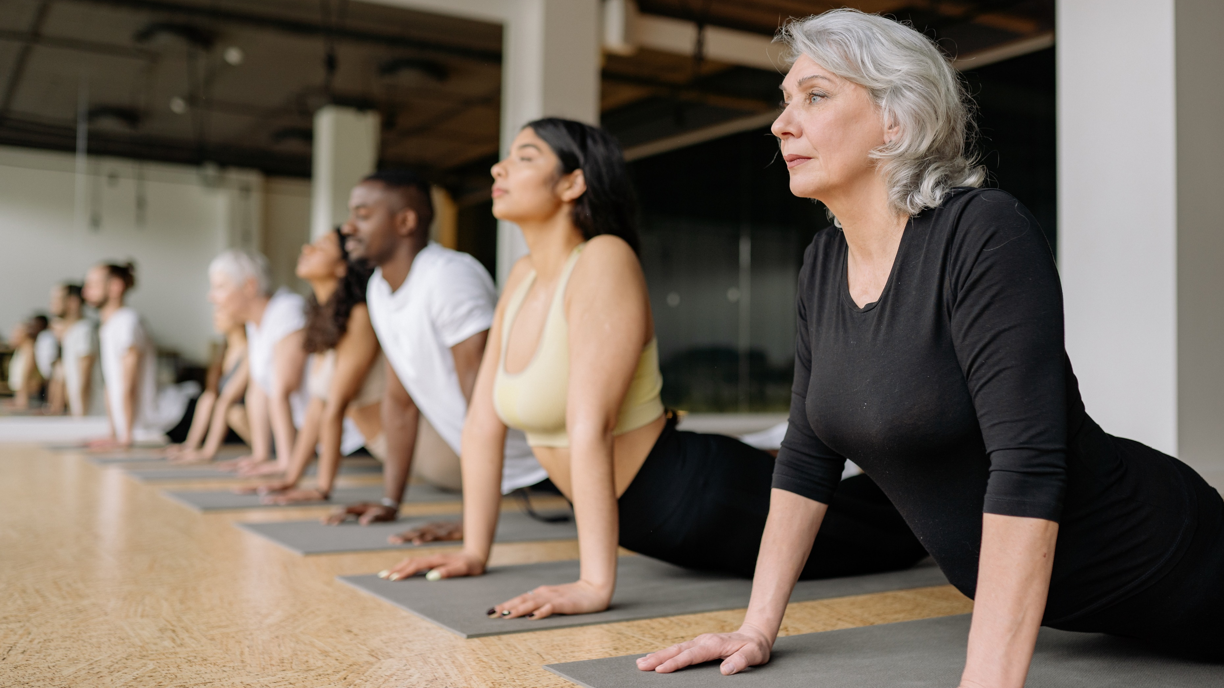
Support Physical Wellbeing
CHCCCS040 - Support independence and wellbeing (Release 1)

Slide 2


A vital part of supporting a person is taking care of their physical health.
Taking care of a person’s physical health has two meanings:
Taking on tasks they may not be able to do themselves
Monitoring a person's physical wellbeing
You may be on constant alert for signs of deterioration or change in their health.
Support Physical Wellbeing

Slide 3
Wellbeing
Wellbeing is a state that a person can achieve.
There is no universal definition of wellbeing, but the following common points are usually part of achieving positive wellbeing:
Being healthy
A healthy person is someone who has maximised their bodily functions.
Being happy
A happy person usually experiences more positive emotions than negative ones.
Support Physical Wellbeing

Slide 4

There is no universal definition of wellbeing, but the following common points are usually part of achieving positive wellbeing:
Being prosperous
A prosperous person is someone who can meet their material needs.
Support Physical Wellbeing

Slide 5
Complete wellbeing means satisfying the requirements for the different aspects or components identified as follows:
Physical
Psychological
Social
Spiritual
Cultural
Financial
Career/occupation
Support Physical Wellbeing

Slide 6
Physical Wellbeing
It is the state of a person according to their physical health that may involve:
Free of or being able to manage any health conditions
Taking care of the body by making positive choices
Can do daily activities without undue fatigue.
Support Physical Wellbeing

Slide 7
Basic Requirements for Good Health
To be healthy requires a holistic approach to taking care of the body.
A healthy person should satisfy the following aspects:
Nutrition and Hydration
Exercise
Hygiene
Support Physical Wellbeing

Slide 8

To be healthy requires a holistic approach to taking care of the body.
A healthy person should satisfy the following aspects:
Lifestyle
Oral Health
Mental health
Support Physical Wellbeing

Slide 9
The third stage in supporting independence and wellbeing is through supporting physical wellbeing.
In order to support physical wellbeing, you must:
Promote and encourage daily living habits that contribute to a healthy lifestyle
Support and assist the person in maintaining a safe and healthy environment
Recognise hazards and report according to organizational policies and procedures
Support Physical Wellbeing

Slide 10
The third stage in supporting independence and wellbeing is through supporting physical wellbeing.
In order to support physical wellbeing, you must:
Identify and report variations in a person’s physical condition
Recognise and report physical indications that may affect a person’s wellbeing
Identify and report physical health situations beyond the scope of your role
Support Physical Wellbeing

Slide 11
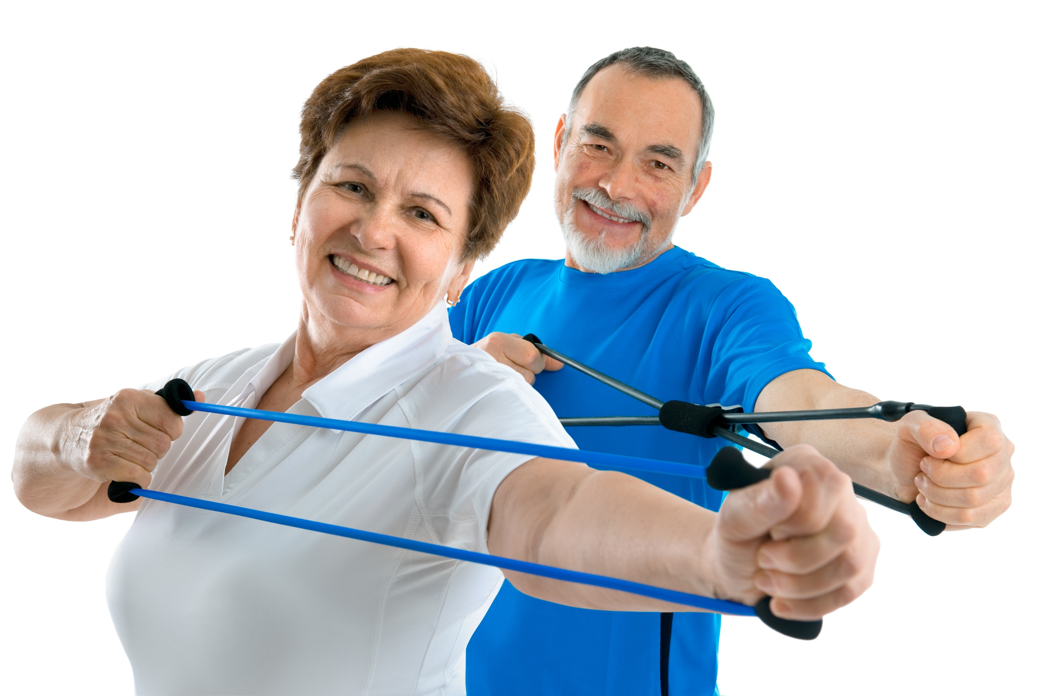
3.1 Promote and Encourage Daily Living Habits That Contribute to Healthy Lifestyle

Slide 12
Daily living habits are the tasks and activities a person does every day.
For the most part, these tasks and activities sustain the persons’ life including:
Sleeping
Exercising
Eating and drinking
Taking a bath
Support Physical Wellbeing

Slide 13
Daily living habits are the tasks and activities a person does every day.
For the most part, these tasks and activities sustain the persons’ life including:
Brushing teeth
Reading
Working
Socialising
Getting dressed
Support Physical Wellbeing

Slide 14
A healthy lifestyle
Is a deliberate decision to think and do things that cause good health
Involves doing daily living habits the right way
Consider the following practices for some positive daily living habits:
Healthy hygiene
Healthy eating and drinking
Healthy sleeping
Support Physical Wellbeing

Slide 15
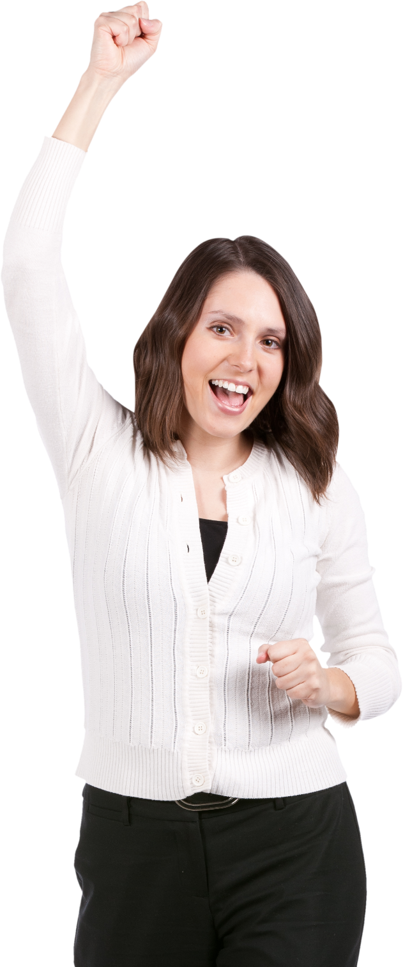
Promoting Daily Living Habits That Contribute to Healthy Lifestyle
In support work, promotion involves deliberate actions that induce positive effects.
Consider the following best practices in promoting a healthy lifestyle:
Considering the person's strengths and preferences in planning
Support Physical Wellbeing

Slide 16
Consider the following best practices in promoting a healthy lifestyle:
Introducing variations to reduce repetitiveness and blandness
Involving the person in planning the activities
Support Physical Wellbeing

Slide 17
Encouraging Daily Living Habits That Contribute to Healthy Lifestyle
To encourage someone is to persuade them to start or continue something.
Consider the following best practices in encouraging a healthy lifestyle:
Discouraging unhealthy activities or choices
Highlighting the benefits of healthy activities
Celebrating small positive changes from lifestyle changes
Always remember that promoting and encouraging a healthy lifestyle involves regular prompting, encouragement and guidance.
Support Physical Wellbeing

Slide 18

3.2 Support and Assist the Person to Maintain a Safe and Healthy Environment

Slide 19
You may work in environments such as the following:
Person’s dwelling
Community centres
Employment services
Residential aged care facilities
Independent living accommodation
Support Physical Wellbeing

Slide 20
As a support worker, you must:
Ensure that they are safe and healthy
Ensure they are free from unintentional harm
Promote positive aspects or changes
Provide them information and motivation
Assist them in their tasks with their corresponding goal or product
Support Physical Wellbeing

Slide 21
Maintaining a Safe Environment
Safety covers elements that may cause unintentional harm.
Maintaining safety means fixing, removing, or reducing these elements in your work.
Examples of these unsafe elements are the following:
Steep stairs
Broken furniture
Inactive fire alarms
Some house chemicals
Support Physical Wellbeing

Slide 22
Examples of these unsafe elements are the following:
Wet spots on the floor
Exposed electrical wires
Misplaced sharp objects
Loose objects on the floor
Unattended heating objects
Support Physical Wellbeing

Slide 23
Supporting the Person to Maintain a Safe Environment
Sometimes, you may be unable to remove unsafe elements.
In these cases, you will have to provide solutions such as:
Encourage the person to use a walking aid, especially if they have mobility issues
Inform the person of all the potential hazards around them. updating them regularly about these hazards will also help
Encourage the person to seek help if they cannot do a task alone. let them know that asking for help from time to time is normal.
Support Physical Wellbeing

Slide 24
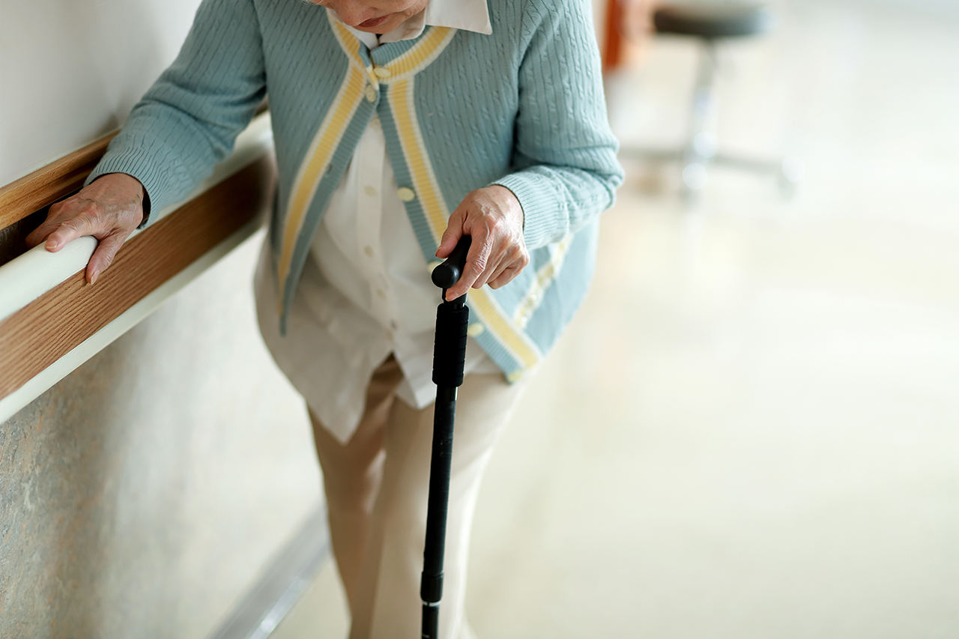
Assisting the Person to Maintain a Safe Environment
Some practices that assist in maintaining a safe environment:
Move the vulnerable person down if living upstairs.
Install handrails and anti-slip mats in bathrooms.
Secure dangerous and sharp objects like scissors, kitchen knives and explosives, in a safe location.
Support Physical Wellbeing

Slide 25
Assisting the Person to Maintain a Safe Environment
Some practices that assist in maintaining a safe environment:
Keep most cleaning products in a secure locations, as they are harmful when ingested.
Diligently monitor use of heating elements like stoves and toasters.
Support Physical Wellbeing

Slide 26
Supporting and assisting the person’s safe environment may come at different levels.
It will come down to how much control you will have over the environment.
You have higher control over places like community centres, offices and care facilities.
You have lesser control over the person’s own dwelling.
Support Physical Wellbeing

Slide 27

Maintaining a Healthy Environment
A healthy environment prevents people from contracting diseases and illnesses.
You must remove elements that may cause short-term and long-term health issues.
Support Physical Wellbeing

Slide 28
Living and non-living elements that can cause diseases and illnesses:
Unhealthy living elements | Unhealthy non-living elements
Mosquitoes Bacteria Moulds Ticks Flies | Carbon monoxide Poor ventilation Pollen and dust Asbestos Lead
Support Physical Wellbeing

Slide 29

In most cases, proper cleanliness and hygiene are practical solutions to address these issues.
This also means doing regular clean-ups of the premises.
Support Physical Wellbeing

Slide 30
Supporting the Person to Maintain a Healthy Environment
The following can help maintain a healthy environment:
Encourage the person to maintain good hygiene.
Educate the person of the common health hazards in their surroundings.
Encourage the person to be vigilant of any health hazards that may arise and report about these hazards immediately.
Support Physical Wellbeing

Slide 31
Assisting the Person to Maintain a Healthy Environment
The following best practices can also help in maintaining a healthy environment:
Avoid having stagnant water around the premises. Clean water-bearing objects like vases at least once a week.
Pay closer attention to frequently used objects like doorknobs and railings when you clean the premises.
Support Physical Wellbeing

Slide 32
The following best practices can also help in maintaining a healthy environment:
Wash fabric-based items like pillowcases and curtains regularly. Make sure to have spare items to use.
Replace worn out cleaning materials like rags and brooms to increase the effectiveness of work.
Check perishable food items for growth or discolouration then discard them immediately.
Support Physical Wellbeing

Slide 33

The following best practices can also help in maintaining a healthy environment:
Perform some pest control measures in dire cases and according to organisational policies and procedures.
Check if the person has allergic reactions to pet hairs.
Support Physical Wellbeing

Slide 34
The following best practices can also help in maintaining a healthy environment:
Ensure that pipes, containers and appliances are not leaking any smoke or weird smell.
Adapt to seasonal changes and the person’s preferences when it comes to ventilation.
Check with the building custodian or the family about any use of asbestos fibres and lead paint in their buildings.
Support Physical Wellbeing

Slide 35
Much like keeping it safe, control is important for having a healthy environment.
As a support worker, you must:
Always consider who has the highest authority on the premises
Respect and consult the place’s primary caretaker.
A homeowner will have the final say on matters related to their homes.
Organisations will have a more significant influence on their facilities.
Support Physical Wellbeing

Slide 36

3.3 Recognise Hazards and Report According to Organisational Policies and Procedures

Slide 37
Keeping the person safe from harm is another way to support their physical wellbeing.
The risks of harm can be reduced by being aware of hazards.
A hazard is something that can cause harm to the person’s health, safety and wellbeing.
Support Physical Wellbeing

Slide 38
Consider the pairs of hazards and their associated risks below:
Hazards | Hazard Events
Wet floor | Slipping
Very hot temperature | Dehydration
High salt intake | High blood pressure
Support Physical Wellbeing

Slide 39
Hazard and risk are two terms that are often confused with each other.
A hazard does not pose a risk unless people are exposed to it. A risk arises when people are exposed to a hazard.
Recognising hazards is the first step in keeping the person safe from the harm these may bring.
Support Physical Wellbeing

Slide 40
Recognising Hazards
Categorise hazards to better identify and address them:
Physical hazards
These are material objects or controllable conditions.
Environmental hazards
These are mostly uncontrollable events and conditions.
Physiological hazards
These are objects, events, or conditions that cause health-related harm.
Support Physical Wellbeing

Slide 41
Assess the person’s lifestyle to determine the hazards.
Assessed aspects will depend on the needs of the person.
These may be the person’s:
Current living conditions
Relationships
Day-to-day activities
Support Physical Wellbeing

Slide 42
The assessment may include the following:
Observing the person and documenting results
Interviewing the person and their family members and carers
Accessing and reviewing the person’s existing records, such as medical history
Consulting the person’s health services provider, such as their physiotherapist or medical doctor
Support Physical Wellbeing

Slide 43
Reporting Hazards According to Organisational Policies and Procedures
Part of your job role is to report any hazard to prevent incidents in the workplace. Doing so will not only protect you, but it will also protect the client and everyone else.
Different organisations may have different policies for reporting hazards.
There may be instances where hazards are reported verbally. In other cases, you would have to submit a written report.
Support Physical Wellbeing

Slide 44
Reporting Hazards According to Organisational Policies and Procedures
For verbal reporting, you might have to consider the following:
Who should you report to?
What is the hazard identified and its associated risks?
How urgent should the hazard be addressed?
How will the hazard be addressed?
Support Physical Wellbeing

Slide 45
Reporting Hazards According to Organisational Policies and Procedures
Written reports serve as documentation of the hazards identified.
A form that your organisation may use is a Hazard Identification report form. This includes details about the following:
The location of the hazard identified
A description of the hazard
Affected persons
Associated risks
Control measures to prevent the hazard from occurring
Support Physical Wellbeing

Slide 46

3.4 Identify and Report Variations in a Person’s Physical Condition

Slide 47
Observing changes in a person’s physical condition can alert you of additional care they might need.
Changes to a person’s physical state can point to issues that impact health and wellbeing.
They may indicate a developing disease or discomfort that need medical attention.
Support Physical Wellbeing

Slide 48
When monitoring for changes in a person’s physical condition, you can take a look at the following:
Appearance
Variations in appearance are the easiest to check. These can include the following:
Bruises and cuts
Scales and burns
Sores and rashes
Yellow or red eyes
Yellow or red skin
Loss in weight
Support Physical Wellbeing

Slide 49
When monitoring for changes in a person’s physical condition, you can take a look at the following:
Ability
A person may display a sudden ineptitude to some physical tasks. They may also show the following tell-tale signs:
Difficulty in talking
Shallow rapid breathing
Hesitancy in movements
Limited physical movements
Support Physical Wellbeing

Slide 50
When monitoring for changes in a person’s physical condition, you can take a look at the following:
Behaviour
A person may be able to hide certain physical appearances. They may also exert to mask their affected abilities.
In these cases, variations in behaviour may come up, which includes:
Wincing from pain
Memory loss
Low energy
Confusion.
Support Physical Wellbeing

Slide 51
When monitoring for changes in a person’s physical condition, you can take a look at the following:
Communication
The person should communicate any changes or conditions that they have, including:
Talking about pain or discomfort
Pointing to the painful or aching part of the body.
Support Physical Wellbeing

Slide 52
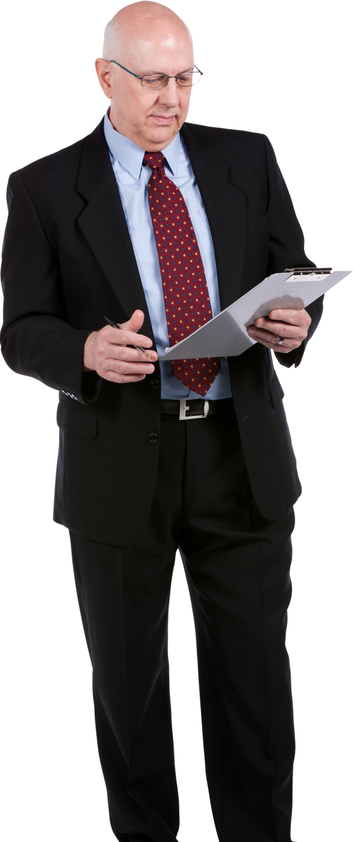
Reporting Variations in a Person’s Physical Condition
Your organisation should also have the necessary policies and procedures for health monitoring.
You should then be familiar with the tools and forms you may use.
Support Physical Wellbeing

Slide 53
Reporting Variations in a Person’s Physical Condition
For health monitoring, you may encounter the following tools and forms:
Progress Notes
These are medical records that track the person’s progress. These are usually detailed accounts of a person’s experience.
Progress notes help in keeping track of the person’s health to detect signs and symptoms early. They can also help document the improving or worsening condition of the person.
Support Physical Wellbeing

Slide 54
Reporting Variations in a Person’s Physical Condition
For health monitoring, you may encounter the following tools and forms:
Incident Reports
These are legal documents that you may do immediately after an incident. Incidents are any events that did happen and brought harm to a person.
Incident reports contain the full details of the event. The details are helpful for both medical and legal use.
Support Physical Wellbeing

Slide 55

3.5 Recognise and Report Physical Indications that May Affect the Person’s Wellbeing

Slide 56
A person’s physical situation may refer to any circumstance that affects them physically. These circumstances include:
Any mobility issues
Any injuries
Effects of illnesses, such as being in pain
Environments that do not meet the person’s needs
Support Physical Wellbeing

Slide 57
Consider the following physical situations that affect the person’s wellbeing:
In constant pain
Physically injured
Stairs in the facility
The climate in the area
A loud neighbourhood
Lack of public transportation
Lack of space for exercise
Limited access to fresh produce
Support Physical Wellbeing

Slide 58
Recognising if a Person’s Situation Affects Their Wellbeing
Some approaches you can try when recognising if the person’s wellbeing is affected by their situation include:
Observation
Observe how the person takes part in different activities. If something feels different from their usual behaviour, look into why this is so.
Communication
Ask the person how they feel and what situation makes them feel that way.
Support Physical Wellbeing

Slide 59
Reporting if a Person’s Situation Affects Their Wellbeing
Organisational policies for reporting anything that affects a person’s wellbeing usually revolve around:
Whom to report
What to report
Where to document observations
Support Physical Wellbeing

Slide 60
Reporting if a Person’s Situation Affects Their Wellbeing
Organisations may have their own templates for reporting.
However, the following are the things you can include in your notes:
The indicators observed
The physical situation that affected their wellbeing
Something that the person said about their wellbeing
Relevant observations that family/carer shared
Action items to help the person
Support Physical Wellbeing

Slide 61

3.6 Recognise and Report Physical Health Situations Beyond Scope of Your Role

Slide 62
Some physical health situations will need a professional response.
As a support worker, you must:
Learn to identify signs of these situations
Always remember that you have limited responsibilities in responding
Have the proper training to have a reporting role
Support Physical Wellbeing

Slide 63
Recognising Physical Health Situations Beyond Your Role
List of the common health problems to look out for:
Hypertension
Heart attacks
Stroke
Type II diabetes
Support Physical Wellbeing

Slide 64
List of the common health problems to look out for:
Asthma
Allergies
Cancer
High cholesterol
Support Physical Wellbeing

Slide 65
One may categorise health situations as:
Emergency – a situation which requires immediate medical attention
Non-emergency – a situation which may need medication or medical advice as soon as possible
For emergencies situations, you must:
Be familiar with your organisational procedures
Remember that they usually involve calling 000
Support Physical Wellbeing

Slide 66
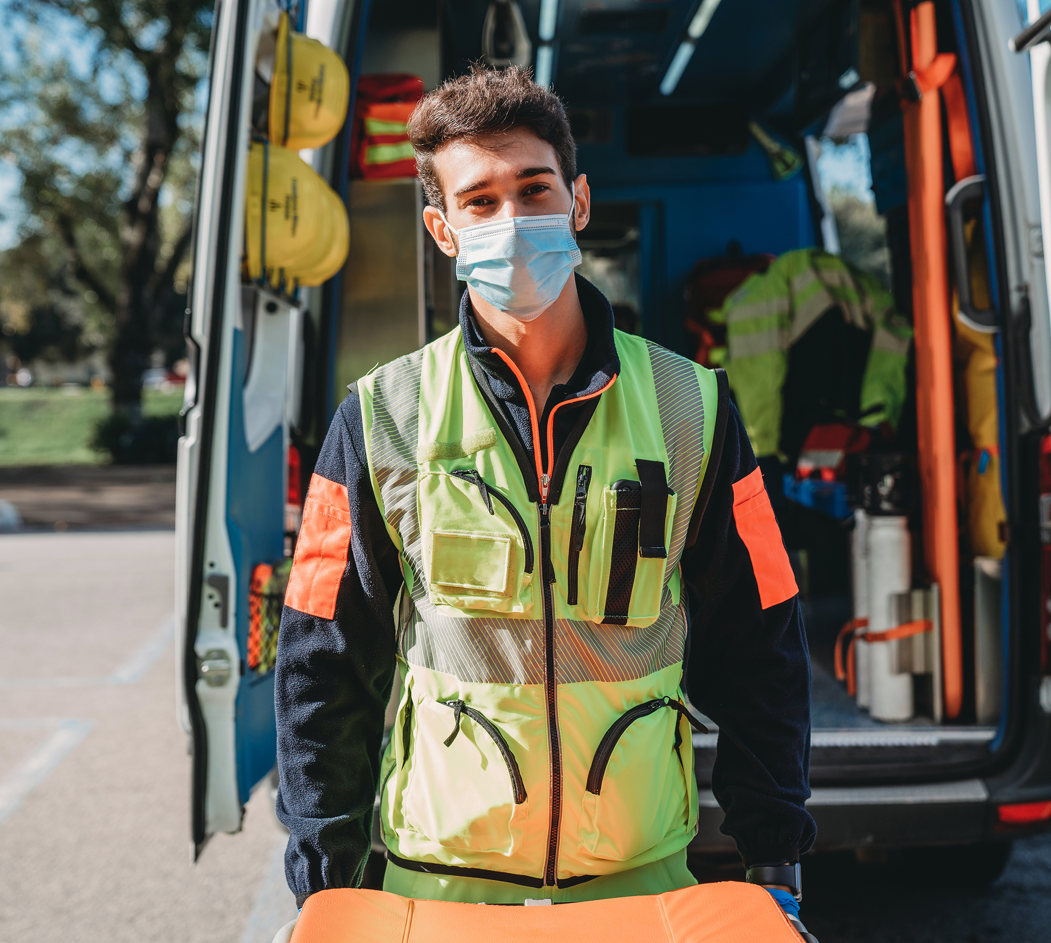
In such cases, someone must call the attention of the professional immediately.
You can only administer intervention or response if:
You are trained, qualified and certified
You are capable at that very moment
As much as possible, professionals must handle emergencies.
Support Physical Wellbeing

Slide 67
For non-emergency situations, early detection and reporting are more important.
These situations are usually for health problems that are:
Mild
Acute
If you need to administer medication, make sure that you are qualified.
The person's individualised plan should explicitly identify you.
Otherwise, seek the help of anyone identified and qualified to administer the medicine.
Support Physical Wellbeing

Slide 68
Reporting Physical Health Situations Beyond Your Role
You may have to report to the following personnel for detected health situations:
Your supervisor
The medical personnel available
The person's assigned medical professional
Support Physical Wellbeing

Slide 69
Like reporting other observations, you must know the answer to the following questions:
What do you have to report?
How should you do the report?
How frequently should you report?
Who do you approach for reports and updates?
How do you contact them during emergencies?
Support Physical Wellbeing

Slide 70

You must be ready with all available information that you may need to forward including:
Progress notes
Incident reports
Medical records
Medication history
Your prompt and proper response may be a difference-maker.
Support Physical Wellbeing

Slide 71

What have we learnt?
In this part of the session, we have covered:
Recognise and support individual differences
Promote independence
Support physical wellbeing
Support social, emotional and psychological wellbeing

Slide 72
End of Chapter 3

